Slide 1
Control Theory(1st)
By JunAng Wang
2023/11/10

Slide 2
Recap
Approximation method
Joint Rod Simulation
Deflection of Uniform Magnetization Rod under Uniform Magnetic Field
Mechanics and Dynamics of Uniform Magnetization Rods

Slide 3
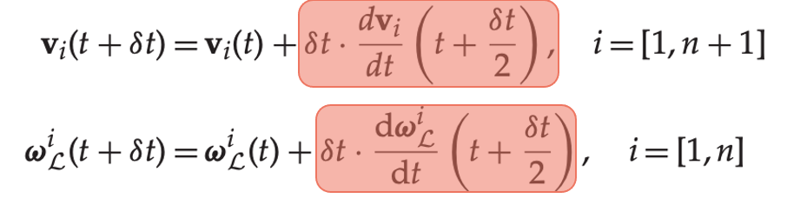
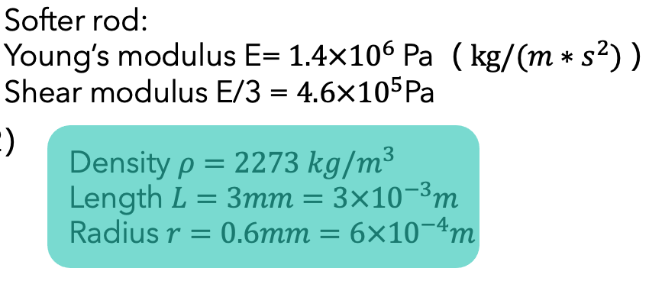
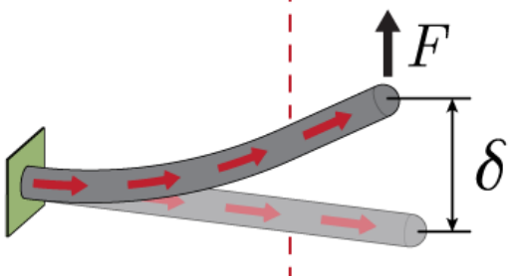
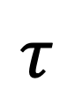
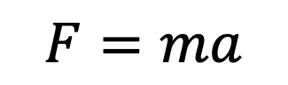
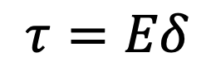
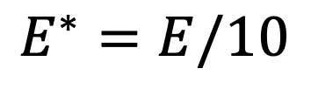
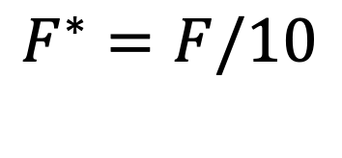
Approximation method
https://github.com/GazzolaLab/PyElastica/issues/310
$$F=ma$$
$$τ=Eδ$$
$$E^{∗}=E/10$$
$$F^{∗}=F/10$$
$$τ$$
Yoonho Kimet al. 2019

Slide 4
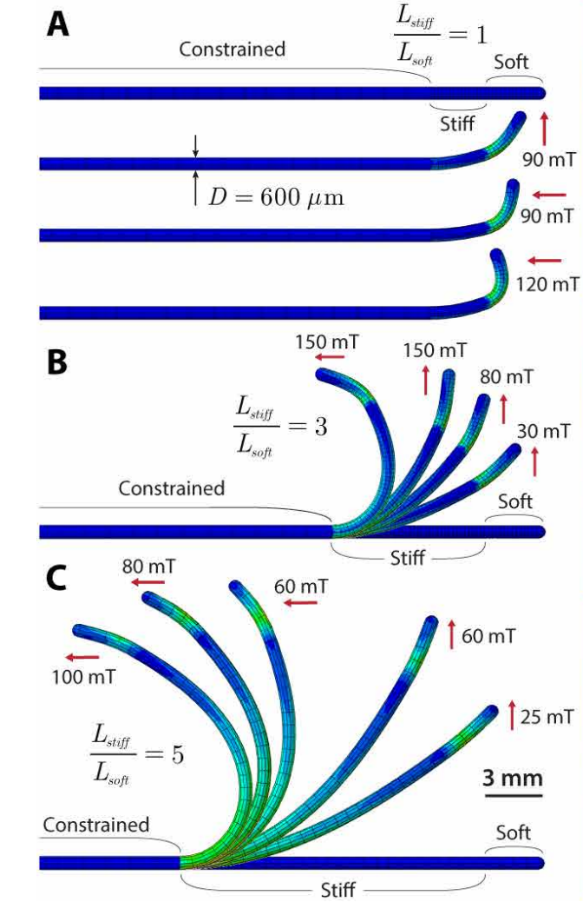
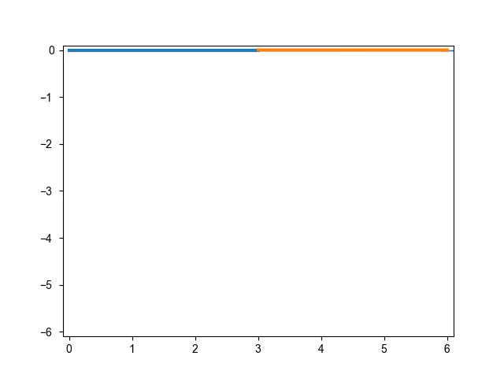
Joint Rod Simulation
F

Slide 5
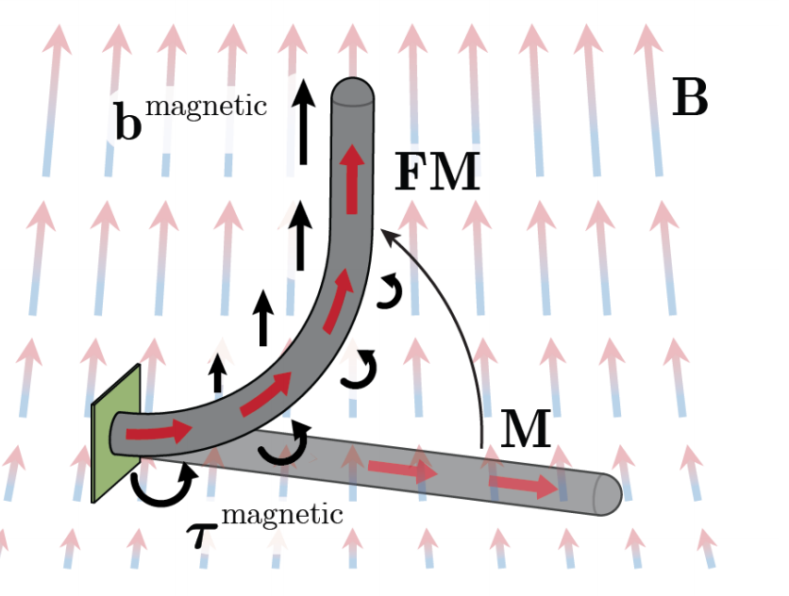
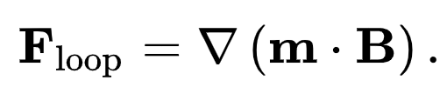
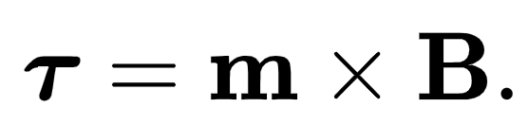
Deflection of Uniform Magnetization Rod
Yoonho Kimet al. 2019

Slide 6
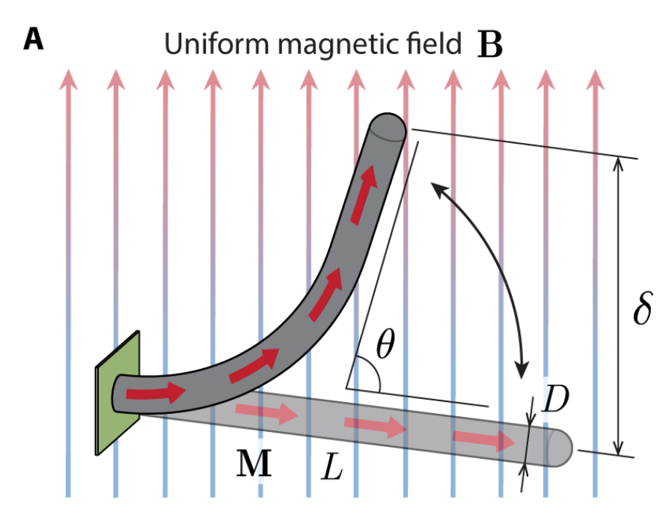
Deflection of Uniform Magnetization Rod
Yoonho Kimet al. 2019

Slide 7
Deflection of Uniform Magnetization Rod
Only torque is considered
Yoonho Kimet al. 2019

Slide 8
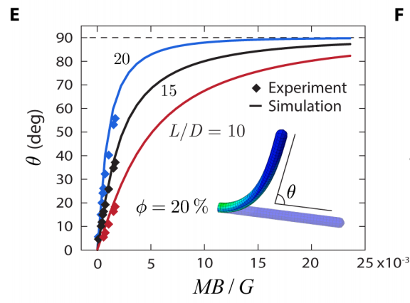
Deflection of Uniform Magnetization Rod
Only torque is considered
Yoonho Kimet al. 2019

Slide 9
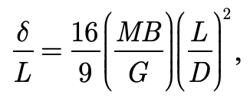
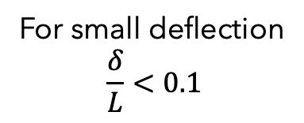
Deflection of Uniform Magnetization Rod
For small deflection
$$\frac{δ}{L}<0.1$$
Only torque is considered
Yoonho Kimet al. 2019

Slide 10
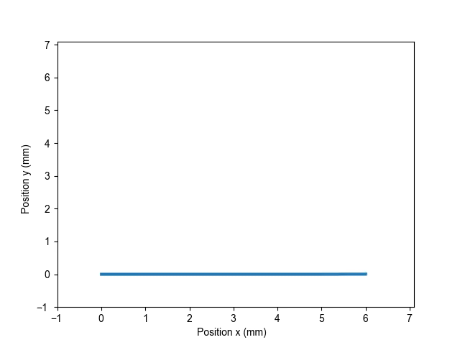
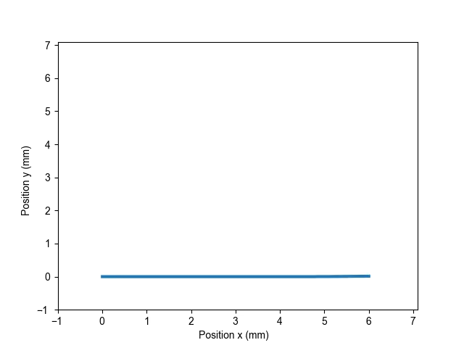
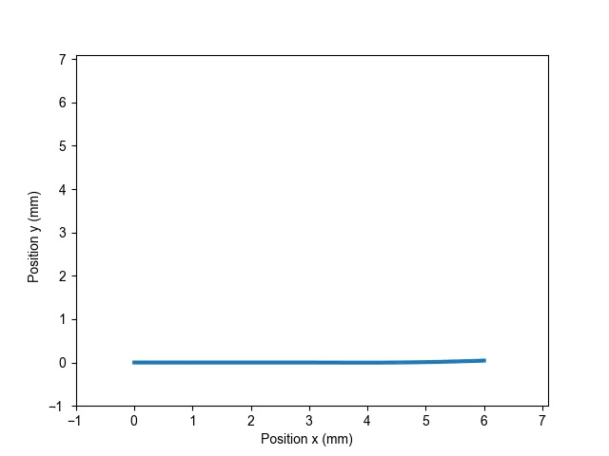
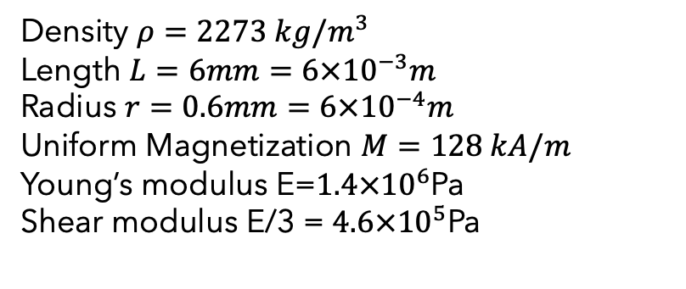
Mechanics and Dynamics of Uniform Magnetization Rods
Density $ρ=2273 kg/m^{3}$
Length $L=6mm=6×{10}^{−3}m$
Radius $r=0.6mm=6×{10}^{−4}m$
Uniform Magnetization $M=128 kA/m$
Young’s modulus E=$1.4×{10}^{6}$Pa
Shear modulus E/3 = $4.6×{10}^{5}$Pa
B = 10mT
B = 30mT
B = 90mT

Slide 11
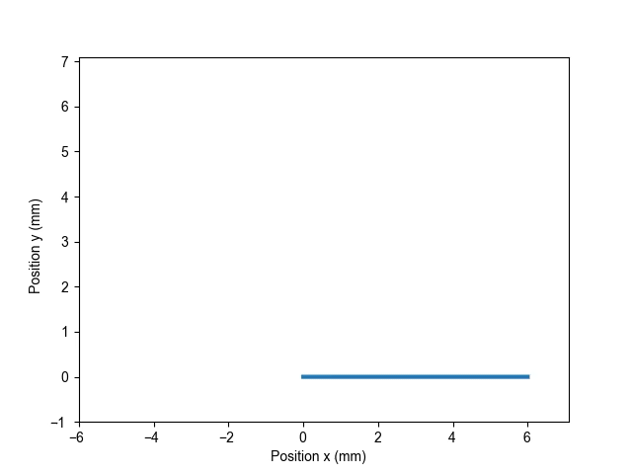
Mechanics and Dynamics of Uniform Magnetization Rods
B = 90mT

Slide 12
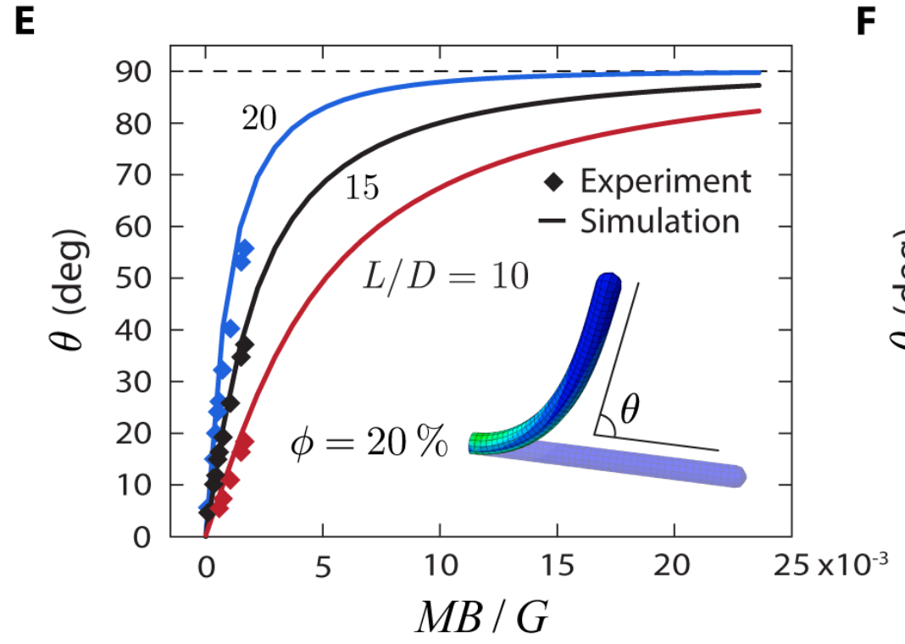
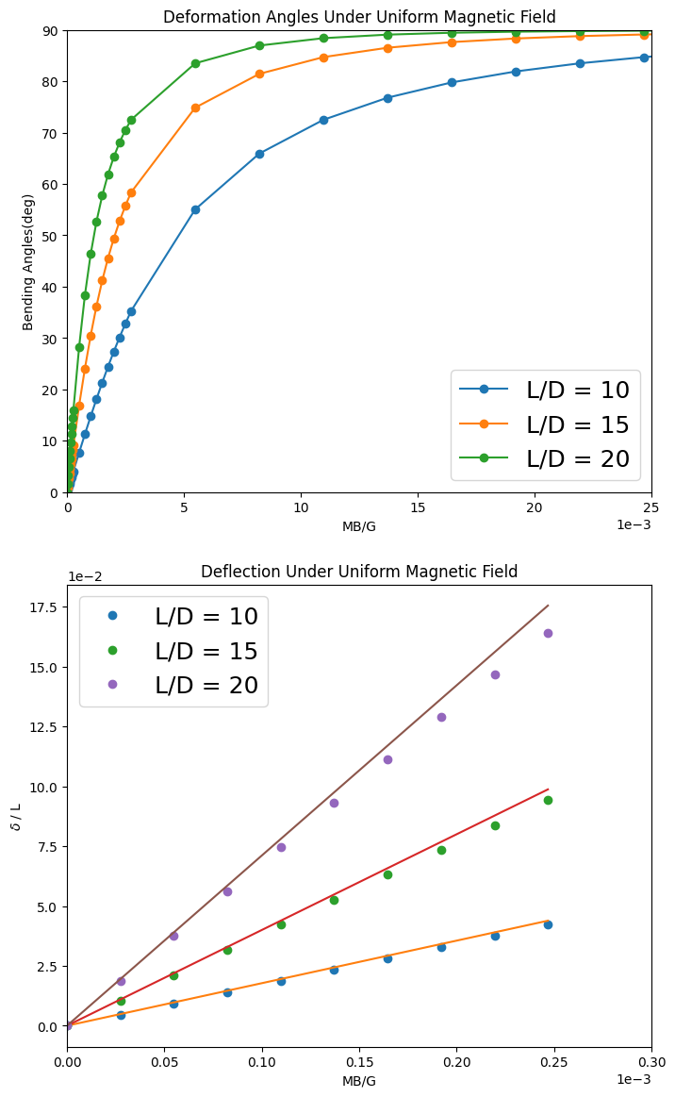
Mechanics and Dynamics of Uniform Magnetization Rods
Yoonho Kimet al. 2019

Slide 13
Mechanics and Dynamics of Uniform Magnetization Rods
Yoonho Kimet al. 2019

Slide 14
Mechanics and Dynamics of Uniform Magnetization Rods

Slide 15
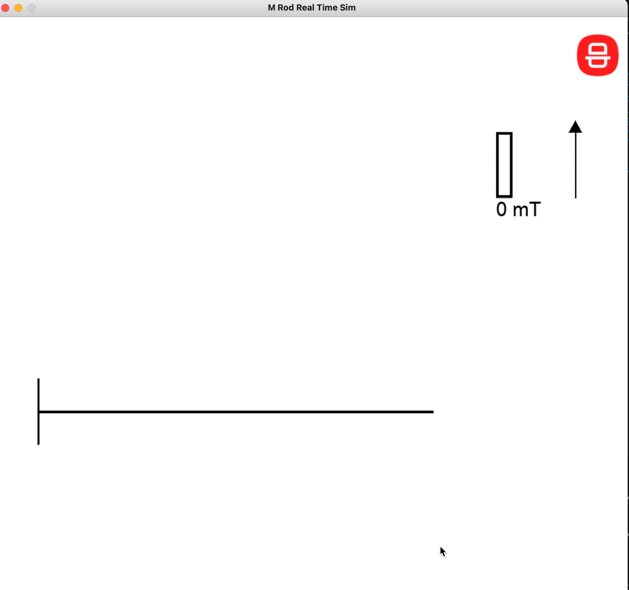
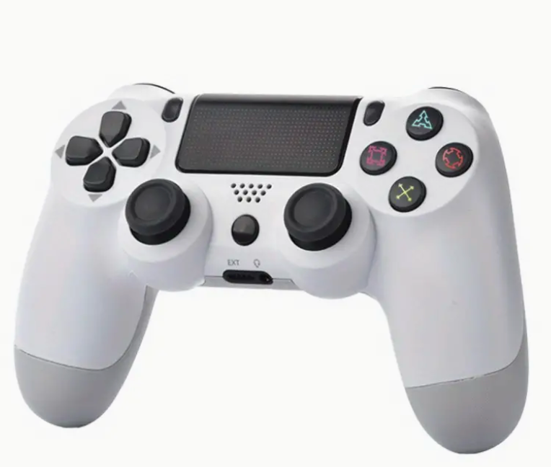
Quasi-Real-Time Simulator

Slide 16
Outlook
Intro of Control Theory
Intro of Control Models
PID controller

Slide 17
Intro of Control Theory

Slide 18
Intro of Control Theory
How do you get a system to do what you want?

Slide 19
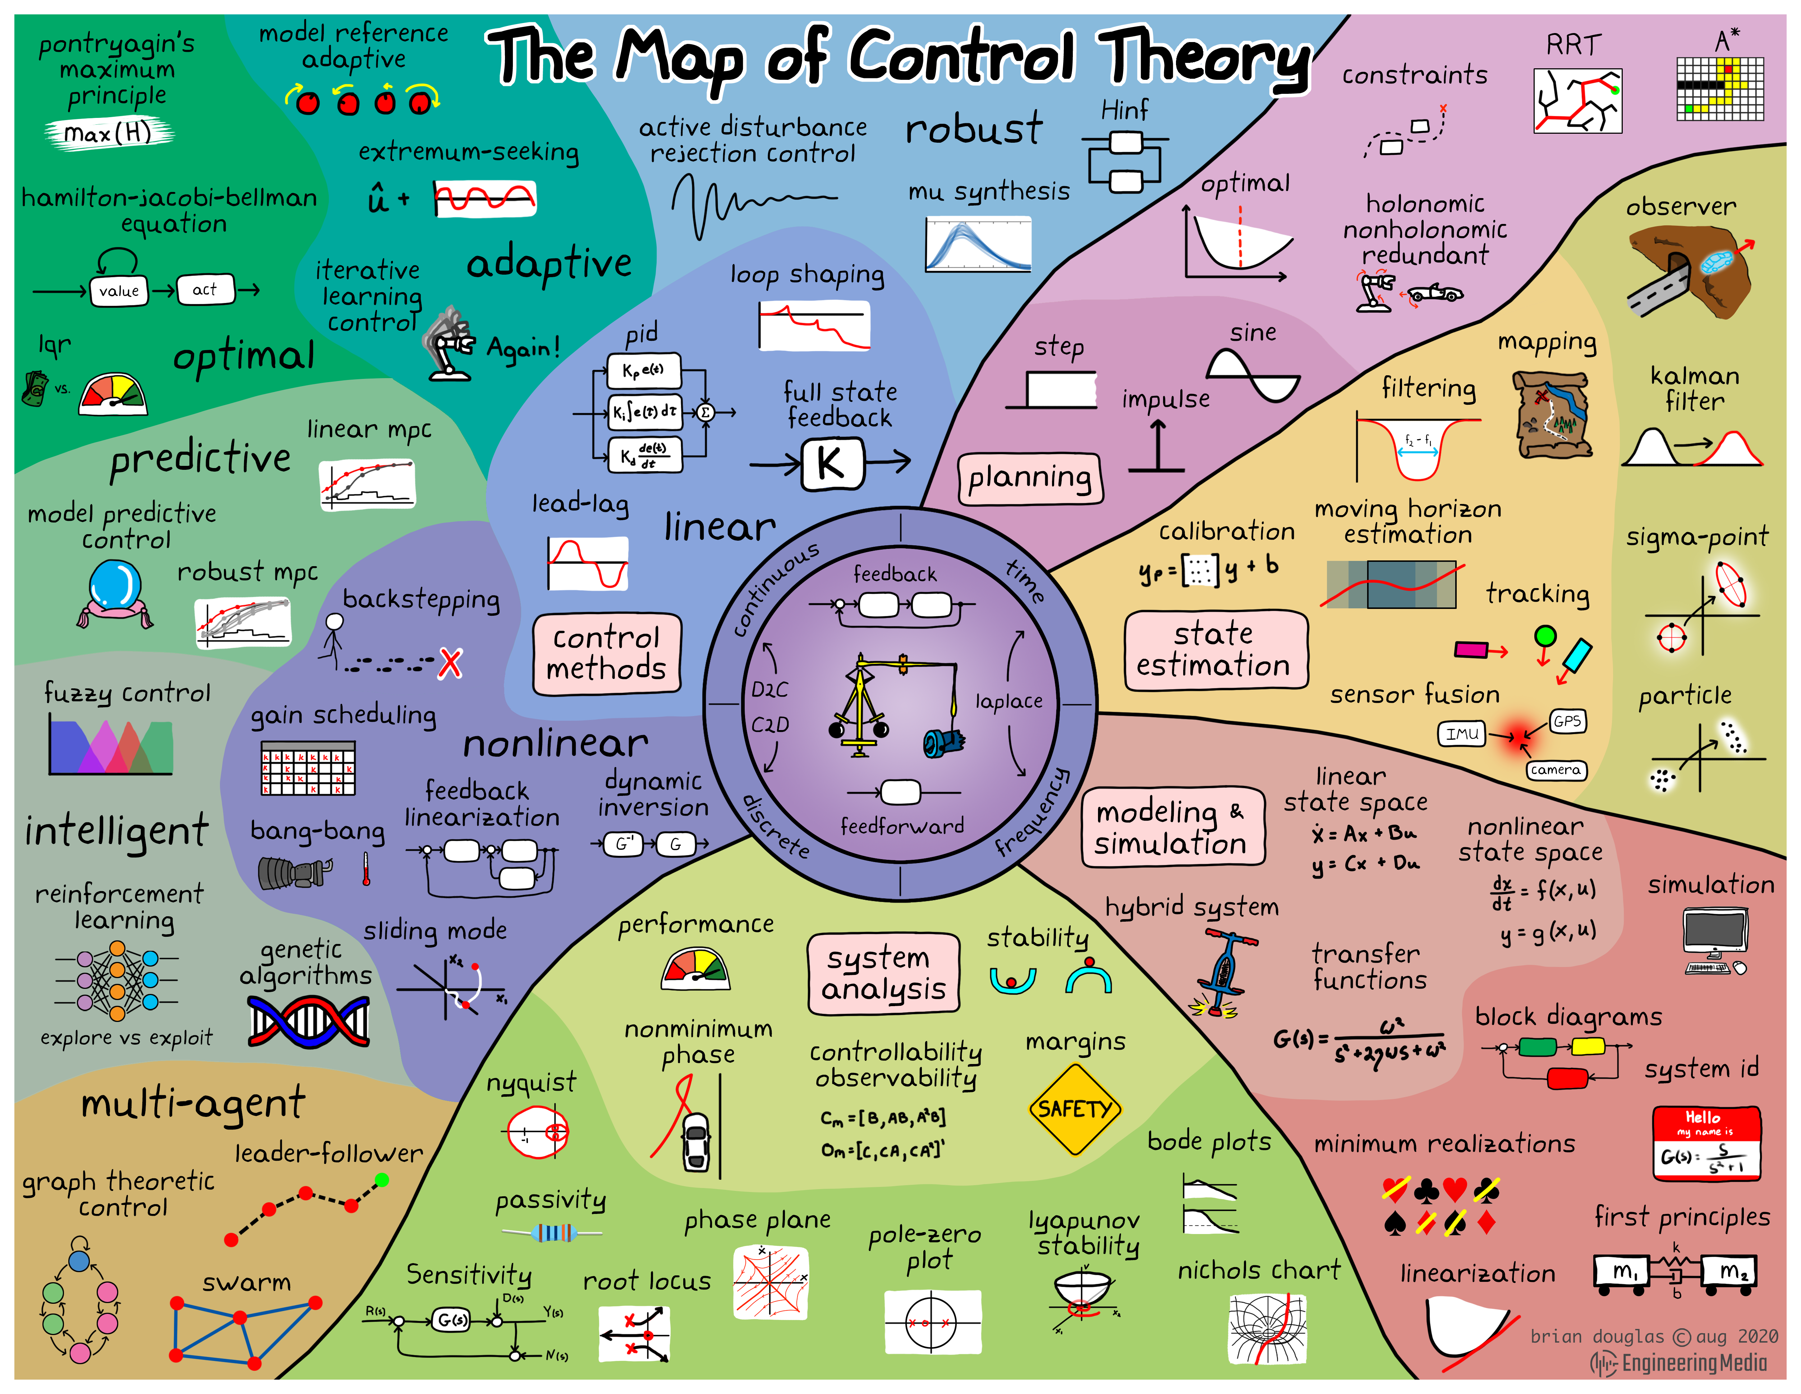
Intro of Control Theory
https://engineeringmedia.com

Slide 20
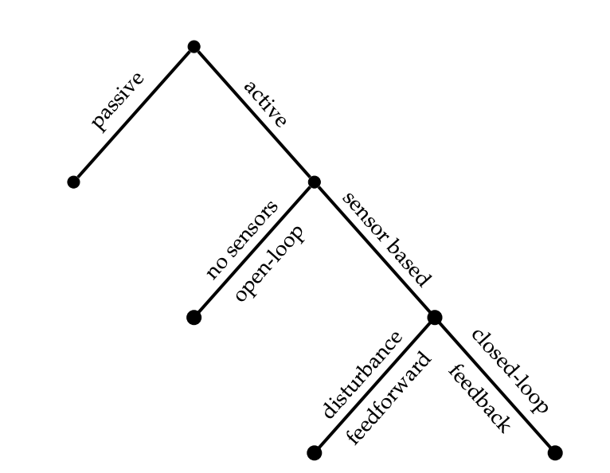
Intro of Control Models
Brunton & Kutz 2017

Slide 21

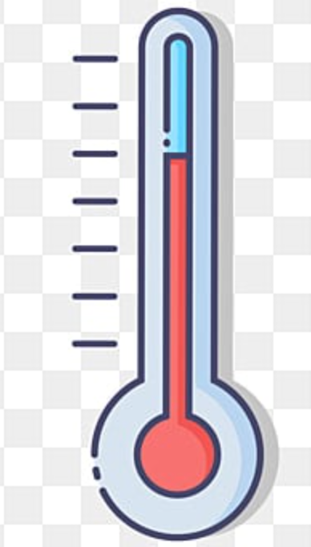
Intro of Control Models
Passive control models
Active control models
Brunton & Kutz 2017

Slide 22

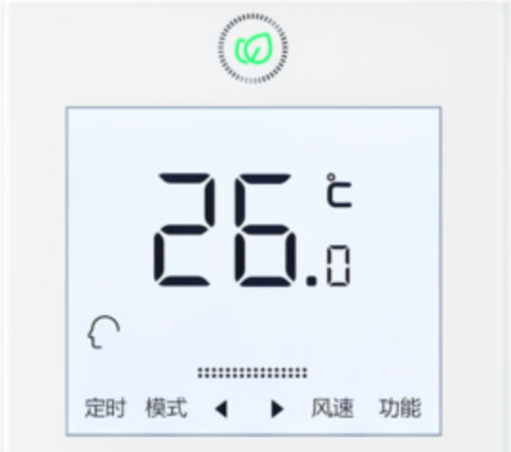
Intro of Control Models
Passive control models
Active control models
Brunton & Kutz 2017

Slide 23

Intro of Control Models
Passive control models
Active control models
Brunton & Kutz 2017

Slide 24

Intro of Control Models
Passive control models
Active control models
Brunton & Kutz 2017

Slide 25
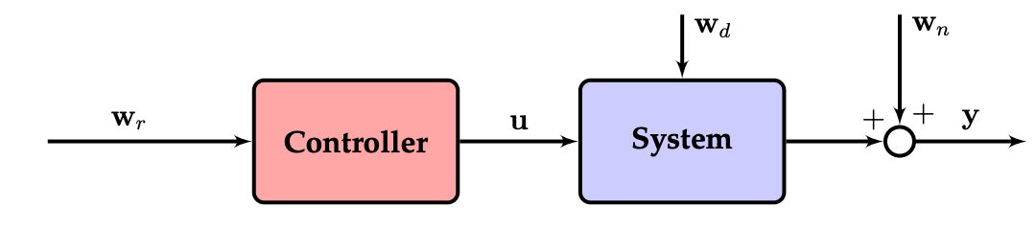
Intro of Control Models
Open Loop control models
Closed Loop control models
Brunton & Kutz 2017

Slide 26
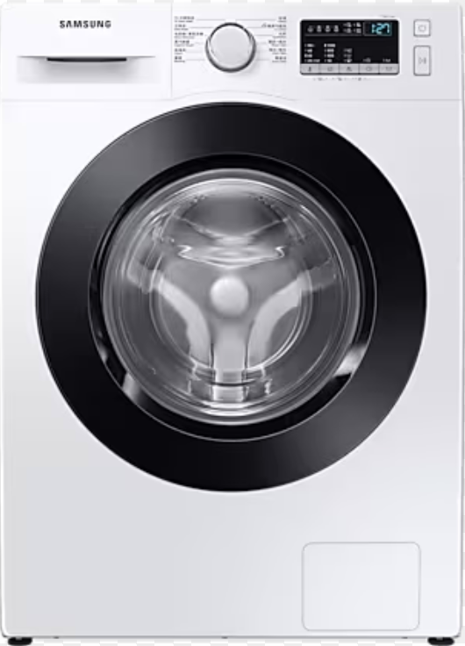
Intro of Control Models
Open Loop control models
Closed Loop control models
Brunton & Kutz 2017

Slide 27
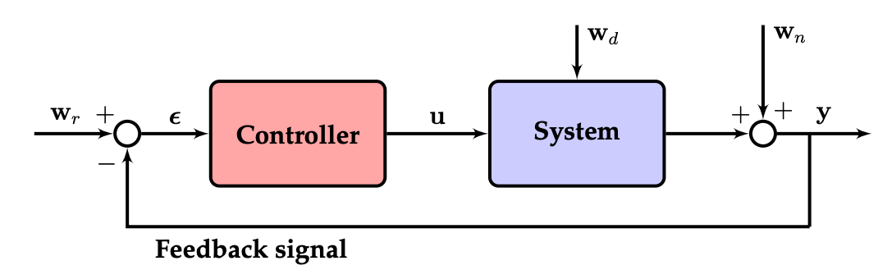
Intro of Control Models
Open Loop control models
Closed Loop control models
Brunton & Kutz 2017

Slide 28
Intro of Control Models
Open Loop control models
Closed Loop control models
Brunton & Kutz 2017

Slide 29
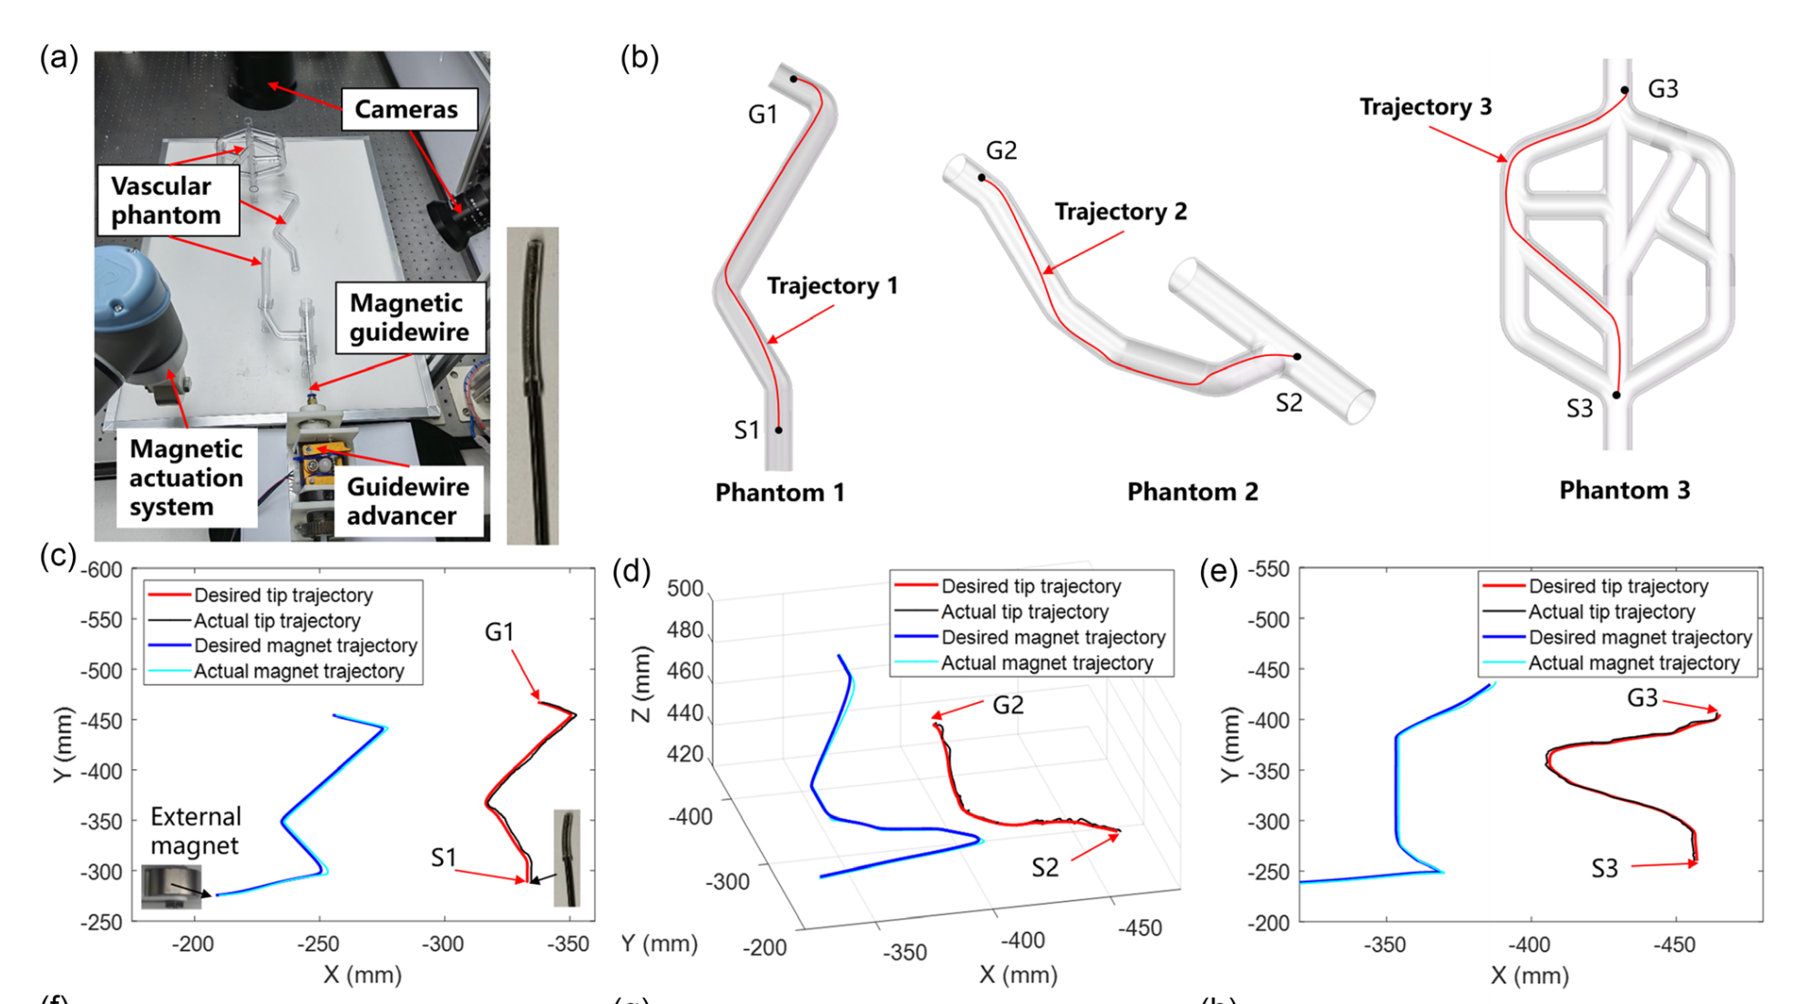
Intro of Control Models
Open Loop control models
Closed Loop control models
Brunton & Kutz 2017
Fu, S., Xu, T. et al. 2023

Slide 30
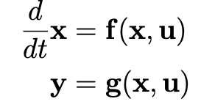
Intro of Control Models
Closed Loop control models
Brunton & Kutz 2017

Slide 31
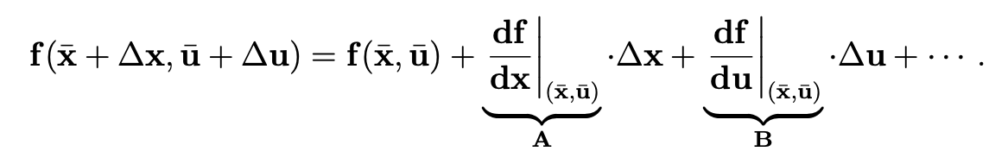
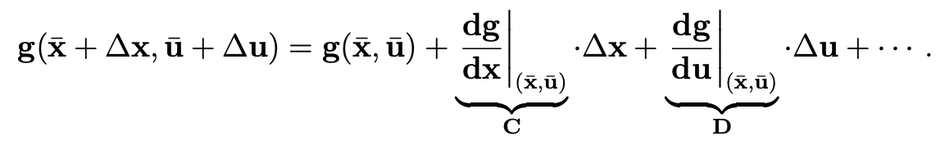
Intro of Control Models
Closed Loop control models
Brunton & Kutz 2017

Slide 32
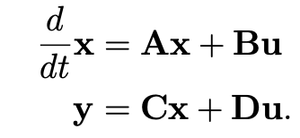
Intro of Control Models
Closed Loop control models
Brunton & Kutz 2017

Slide 33
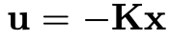
Intro of Control Models
Closed Loop control models
Brunton & Kutz 2017

Slide 34
Intro of Control Models
Closed Loop control models
Linear Controller
Brunton & Kutz 2017

Slide 35
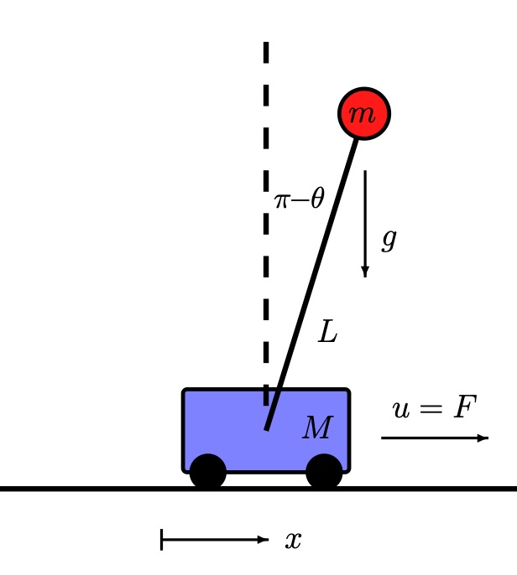
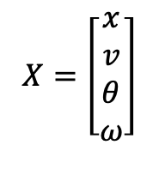
Intro of Control Models
Closed Loop control models
$$X=\left[\begin{matrix}x \\ v \\ θ \\ ω\end{matrix}\right]$$
Linear Controller
Brunton & Kutz 2017

Slide 36
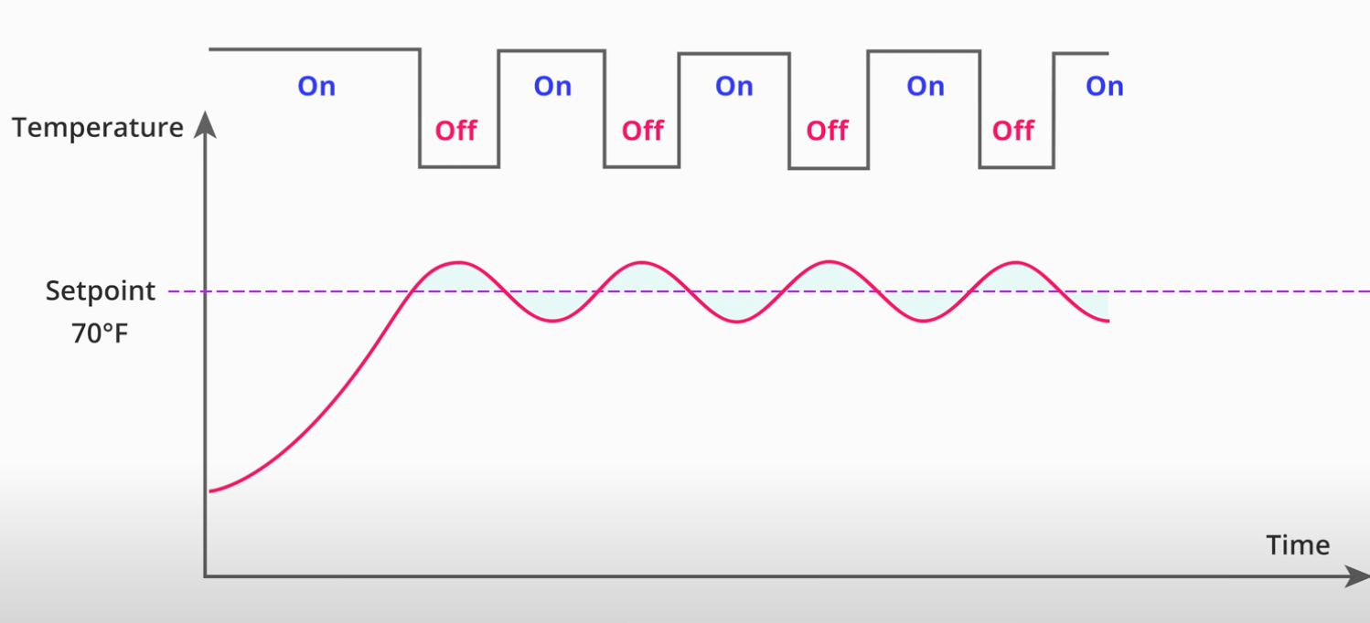
Intro of Control Models
Closed Loop control models
Linear Controller
Brunton & Kutz 2017

Slide 37
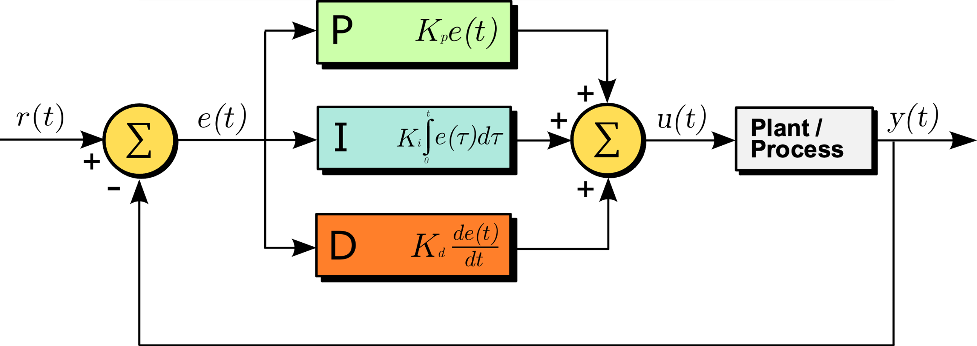
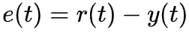
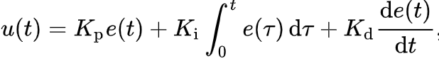
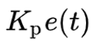
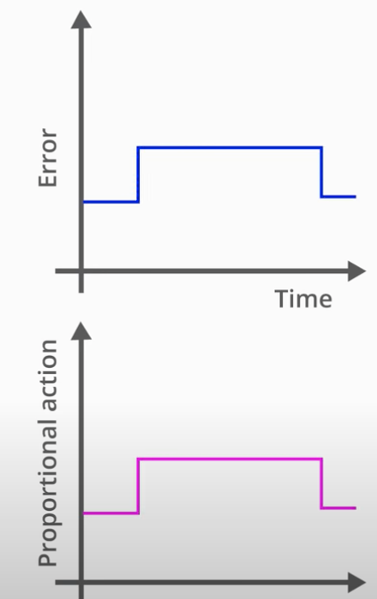
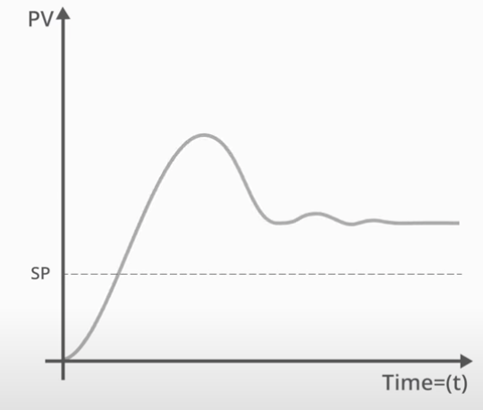
Proportional-integral-derivative (PID)

Slide 38
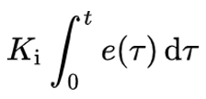
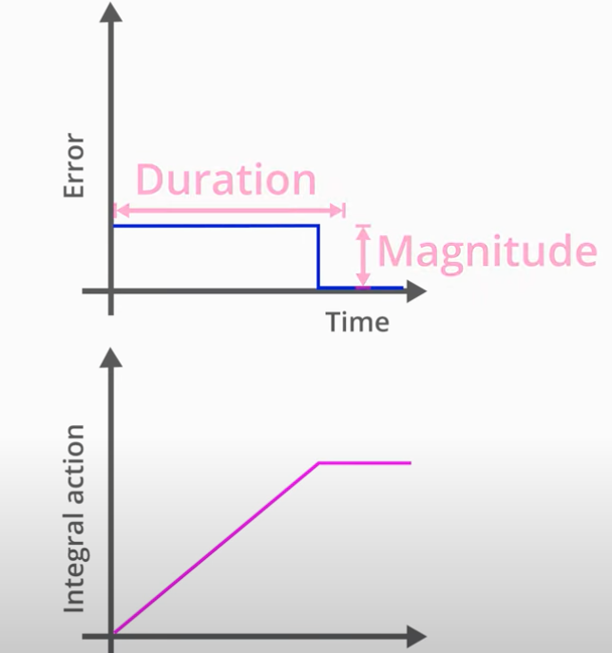

Proportional-integral-derivative (PID)

Slide 39



Proportional-integral-derivative (PID)

Slide 40
Proportional-integral-derivative (PID)
Yoonho Kimet al. 2019

Slide 41


Proportional-integral-derivative (PID)

Slide 42
Remark
Intro of Control Theory
Intro of Control Models
PID controller (but fail)

Slide 43
Outlook
Tune PID Controller
Controllability, Observability, Robustness
Linear Quadratic Regulator
Model Predictive Controller

